Slide 1
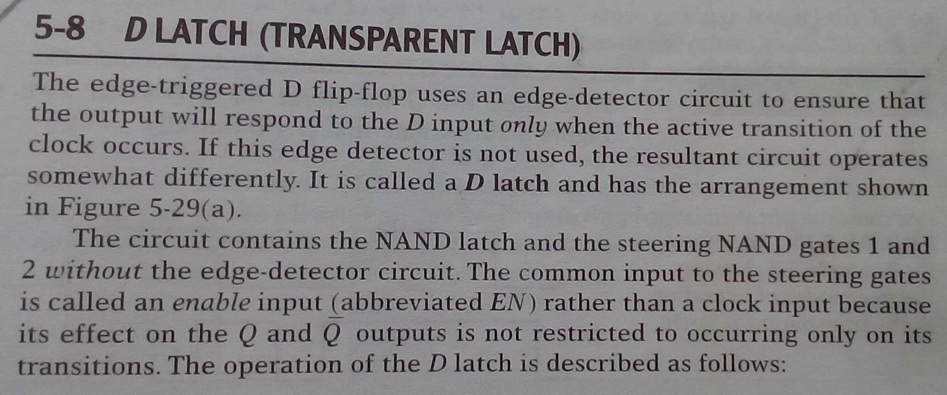
Lecture-16 D- Latch

Slide 2
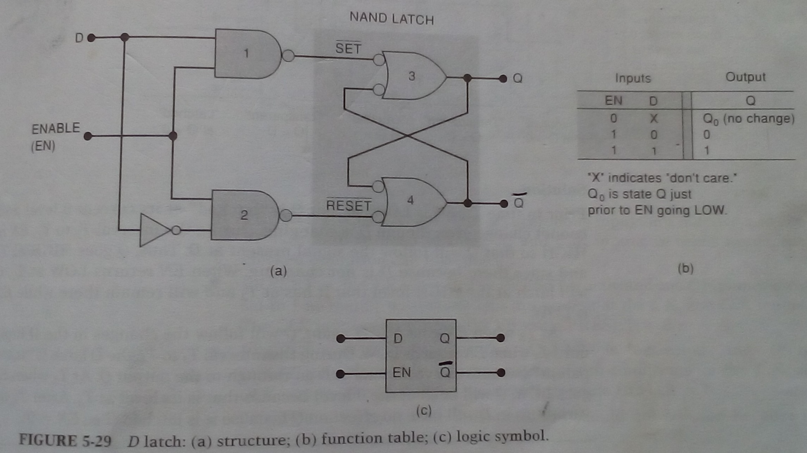
D- Latch

Slide 3
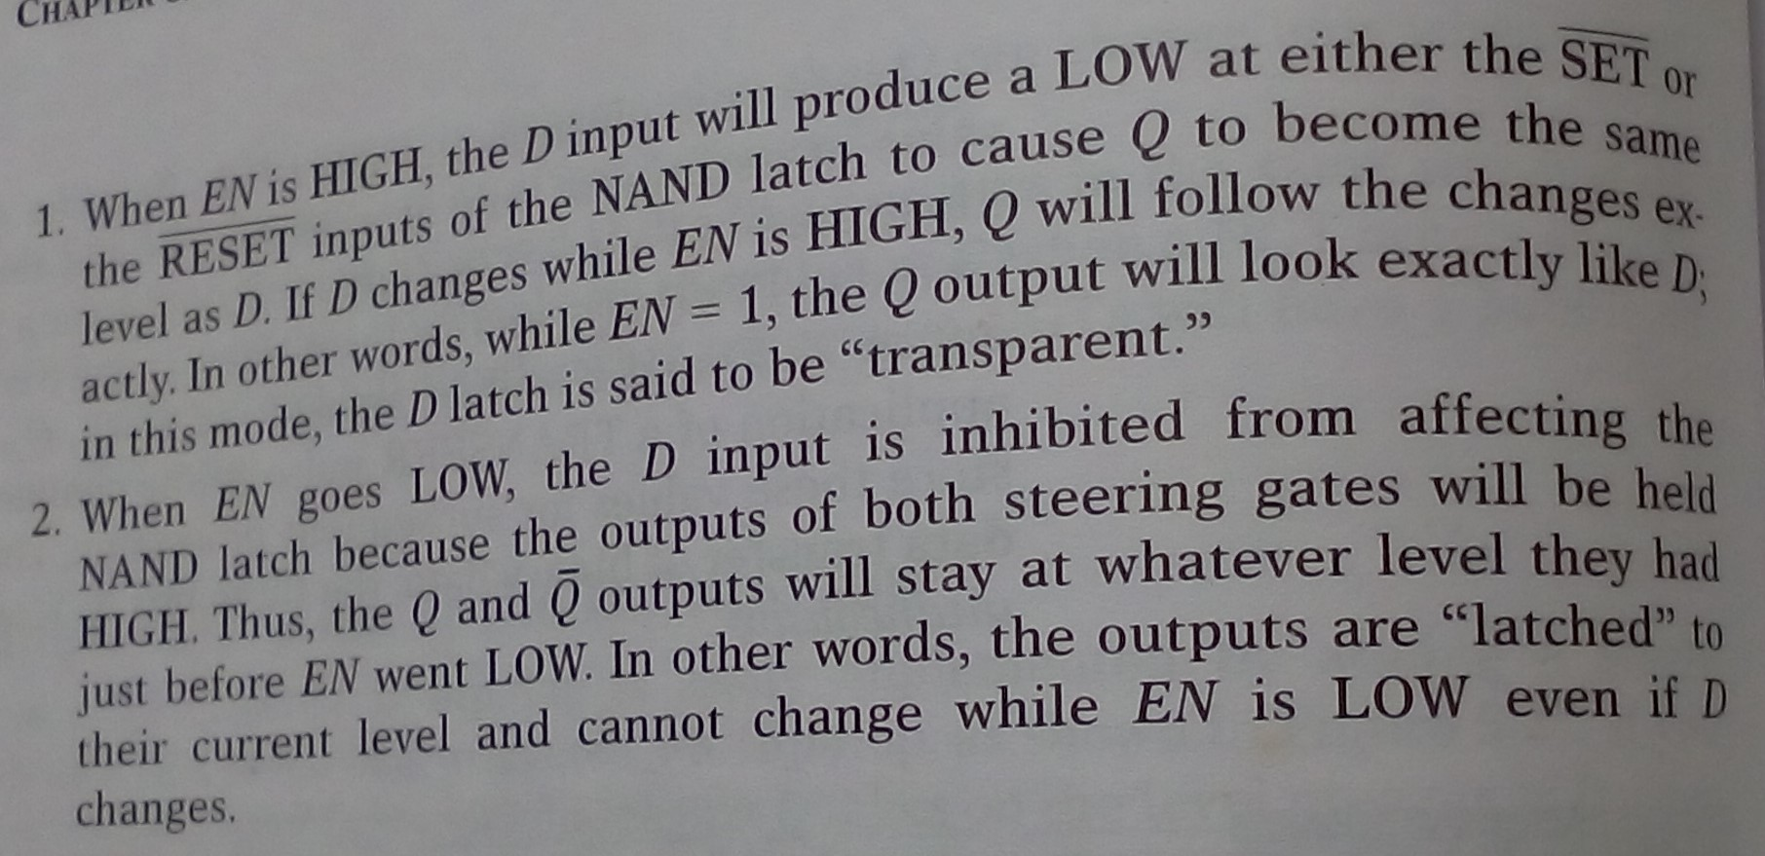
D- Latch

Slide 4

D- Latch

Slide 5
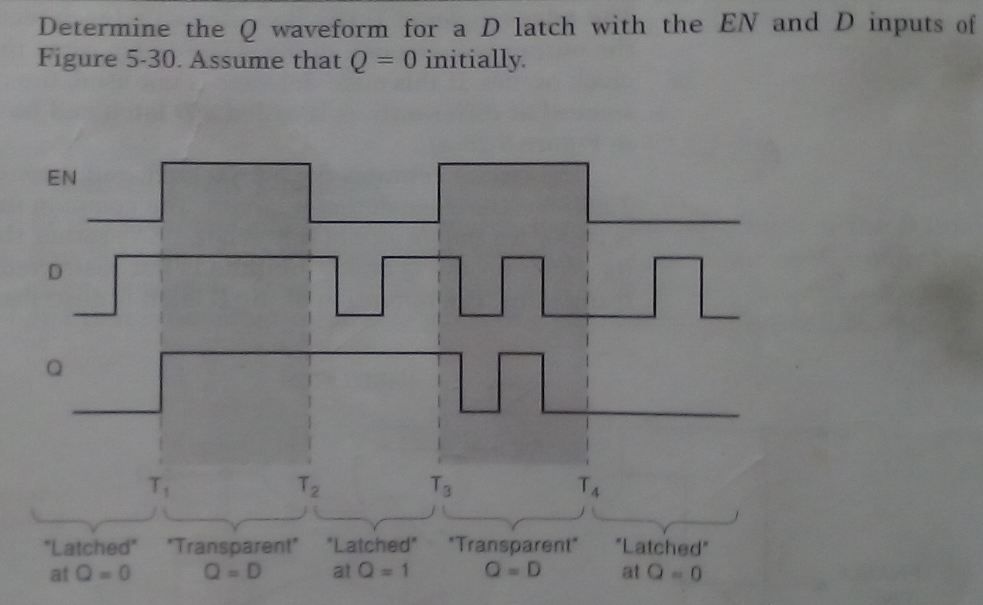
D- Latch

Slide 6
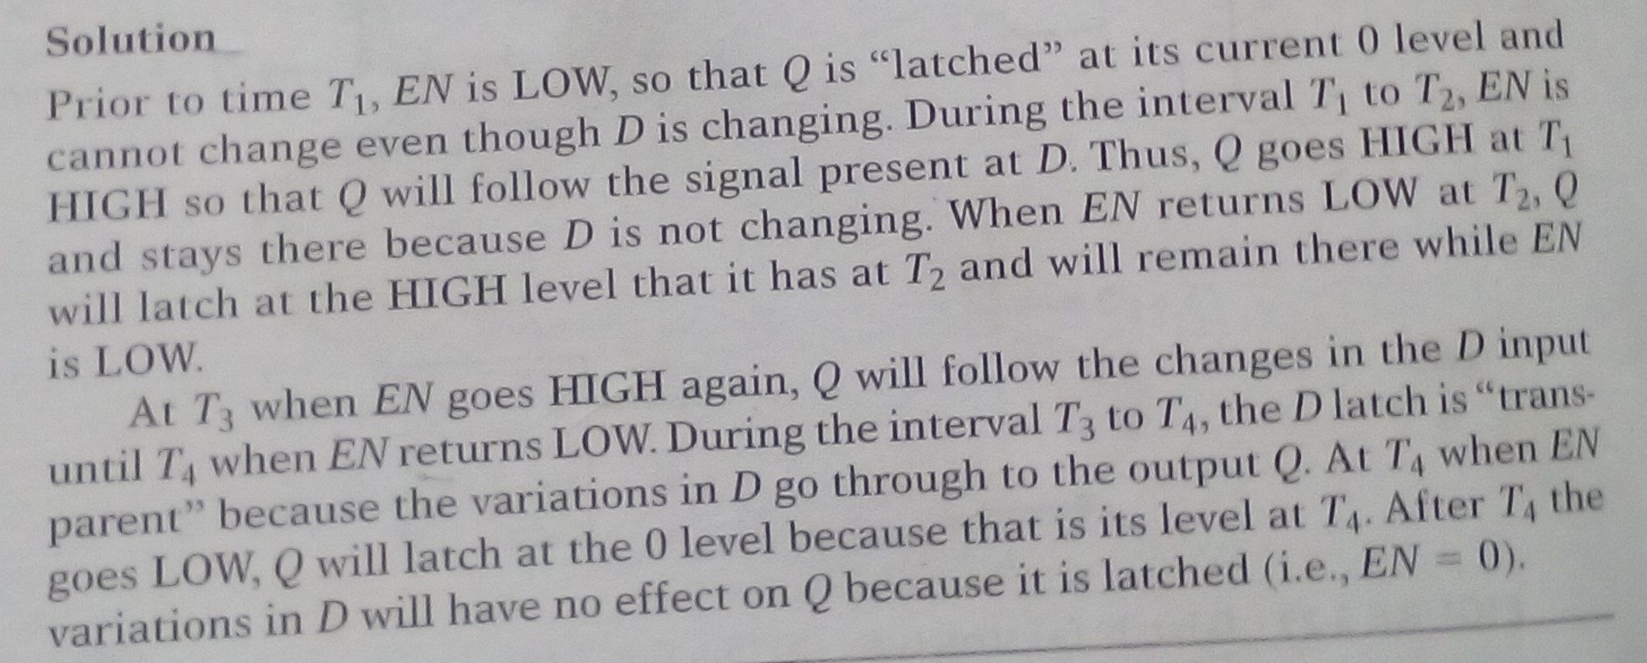
D- Latch

